Slide 1


Slide 2

Meaning of Enlightenment
Background of enlightenment
Social, economic and political reformation

Slide 3

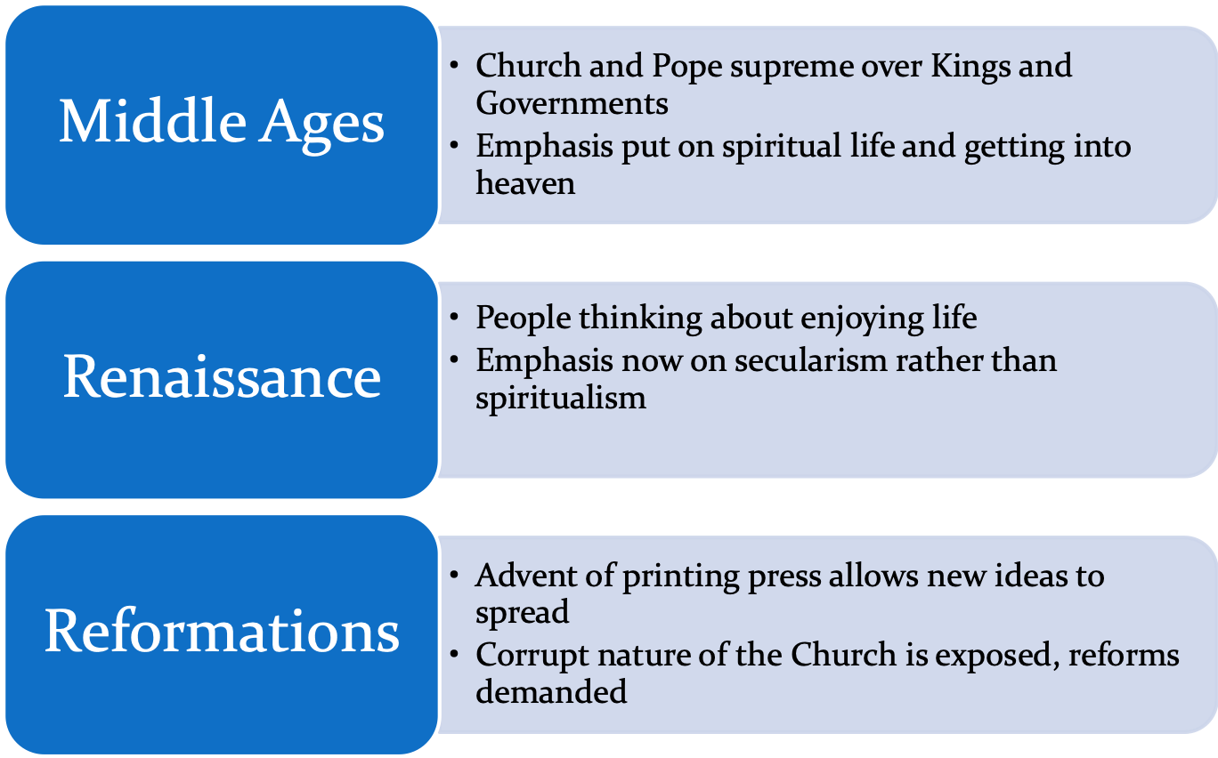

Slide 4
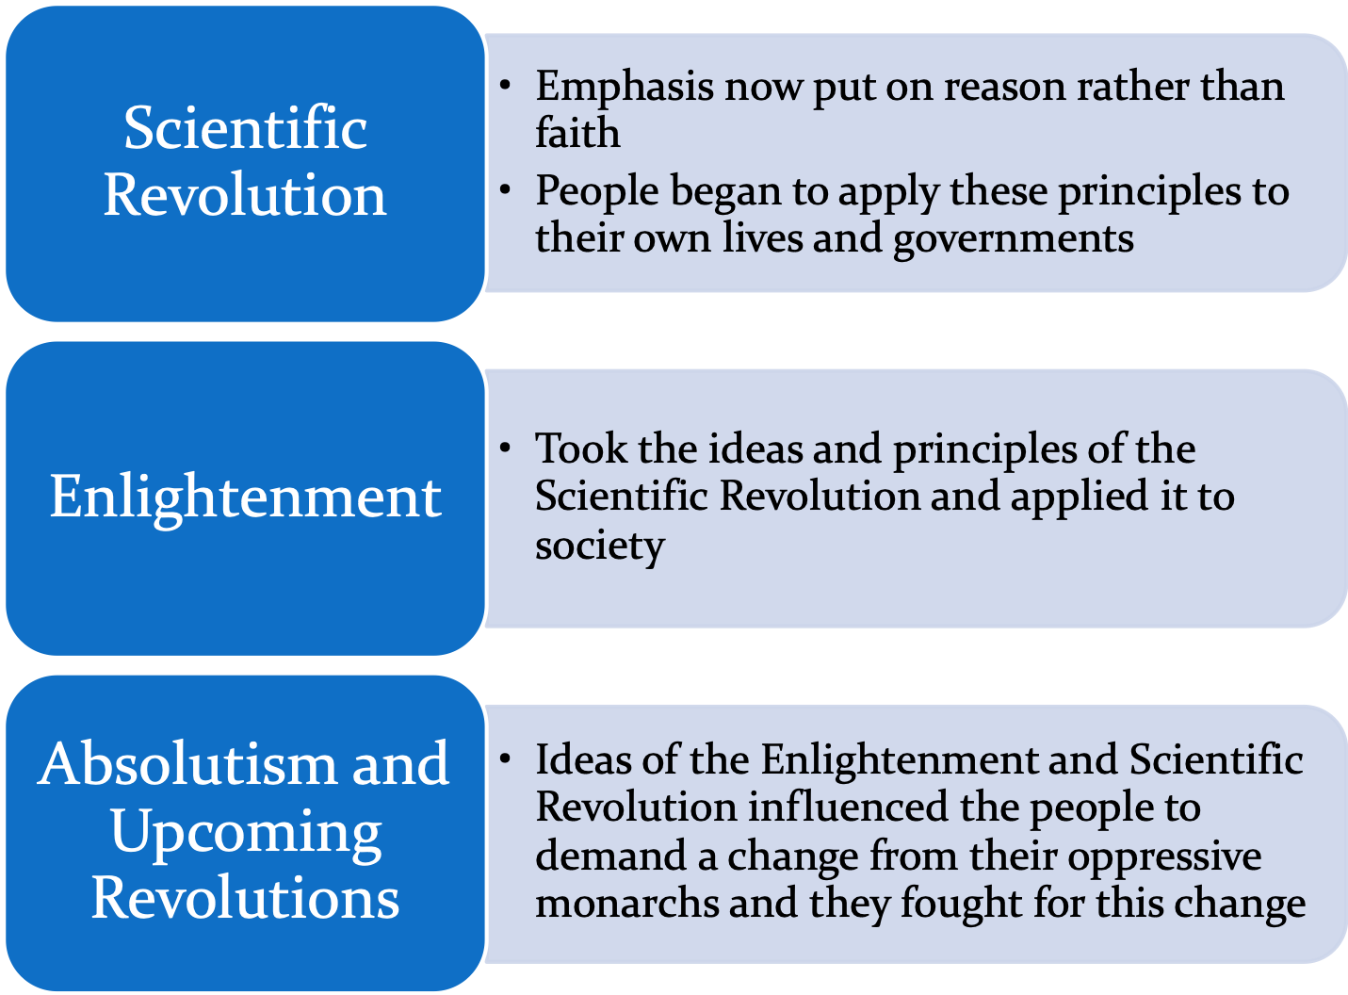

Slide 5



Slide 6

Review: Renaissance and Scientific Revolution
Before Enlightenment, the Renaissance occurred. It led to the Scientific Revolution. All of these time periods are defined by a sense of inquiry, or questioning the established order to find better ways of doing things.
What was the Renaissance?
Golden Age of arts and literature in Western Europe
Rebirth of classical learning
What was the Scientific Revolution?
Scientists begin to question traditional beliefs
Use of logic and reason

Slide 7
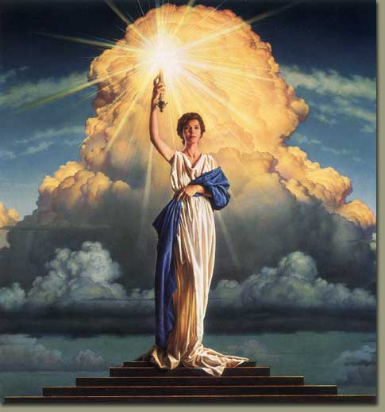
The Enlightenment…
Also known as Age of Reason, the Enlightenment grew out of the Scientific Revolution of the 1500s & 1600s.
Reason could be used to discover natural laws which shape the human experience.
Natural Laws- unchanged principles, discovered through reason, that govern all human conduct

Slide 8
The Enlightenment: Key Aspects
Using methods of modern science, reformers set out to study human behavior and solve the political, social and economic problems of society using reason.
Enlightened thinkers were concerned with the relationship between government and the people, and their ideas were used by many modern nations in the creation of government.
Resulted in the move away from absolutism and divine right (religion) and toward democracy and individual rights (secularism)
https://www.youtube.com/watch?v=J0B28_gwj0M

Slide 9
Ideas that originated during the Enlightenment
      Right to happiness
      Science should be practical
      Discrimination is wrong
      Separation of church and state
      Right to privacy
      Governments should not be all-powerful
      Freedom of speech
      Education reforms
      Seeds of democracy

Slide 10
18th century Enlightenment-The Age of Reason
  Revolution in philosophy
  Philosophers, inspired by scientists, started questioning God and God’s role in society
  Particular emphasis was placed on criticizing government and the church
  Philosophers wrote the words that inspired revolutions

Slide 11
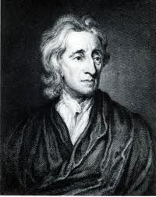
John Locke
Believed that people are basically moral and reasonable.
All people are born free & equal with three natural rights-life, liberty, and property.
Government exists at the consent of the governed to protect their rights.
Wrote Two Treatises of Government stressing the best governments had limited power—not an absolute monarchy.

Slide 12
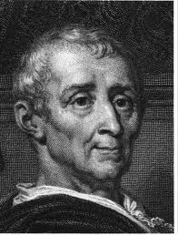
Montesquieu
Criticized absolute monarchies—admired Britain's limited monarchy and said it protected people’s rights.
Believed having 3 branches in government would prevent oppression.
  Having a separation of powers would prevent any one branch from gaining too much power over the other two.
“In order to have…liberty, it is necessary that government be set up so that one man need not be afraid of another.”

Slide 13
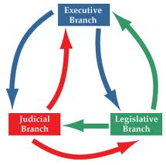
Montesquieu
Believed gov’t should be split into these three branches, and that each branch should be able to serve as a check on the other two:
-Executive (enforces laws)
-Legislative (makes the laws)
-Judicial (applies laws)

Slide 14



Voltaire
“I do not agree with a word you say, but I will defend to the death your right to say it.”
Believed in the freedom of press and used it to expose the abuses of corrupt political and church leaders.
Fought for civil liberties- rights/freedoms of citizens
  Freedom of Speech
  Freedom of Religion
  Separation of Church and State
Believed that humanity’s worst enemies
were intolerance, prejudice & superstition

Slide 15
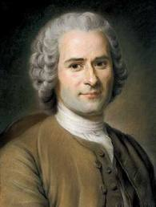
Jacques Rousseau
Believed that people are naturally good, but are corrupted by society.
Unequal distribution of property is a great evil of society.
Stressed the importance of the general will- the will of the people as a whole.
Believed the good of the community should be placed above individual interests- common good.
Hated all forms of political and economic oppression.

Slide 16

Rousseau’s Social Contract
Remember— a social contract is an arrangement where people give up their rights to be protected by the government
Rousseau wrote The Social Contract
where he lays out his ideas of
government and society.
Society places too many limits on
peoples’ behavior- some controls are necessary but should be minimal.
Only governments that had been freely elected should impose law.
Sovereignty should be in the hands of the people, and therefore the only good government is a direct democracy.

Slide 17

New Economic Ideas
Thinkers attempted to solve the economic problems of the day as others tried to solve political problems.
Rejected mercantilism and promoted laissez faire economic practices.
In a laissez faire economy, the government does not interfere with the operations of business.
Mercantilism required government regulation of the economy to achieve a favorable trade balance.
Laissez Faire = Hands Off

Slide 18
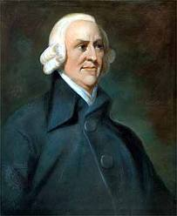
Adam Smith
Smith in The Wealth of Nations, argues for a free market without government interference.
Believed that the forces of supply and demand should run the market—whenever there was a demand for goods or services, suppliers would try to meet that demand in order to gain profits.
Though Smith believed the government should stay out of the economy, he believed that it had a duty to protect society, administer justice, and provide public works.

Slide 19
Enlightenment for Women
Natural Rights were for men only.
Some women were exposed to enlightened philosophy.
Prominent and wealthy women would host informal parties where enlightened thinkers could gather and discuss literature, the arts, science, philosophy and politics.

Slide 20

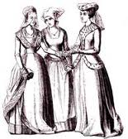
The Spread of Enlightenment
.
Before | After
-Absolute monarchs rule by divine right -Church has authority -Strict separation between nobles and peasants -Suffer in life and be rewarded in heaven | -Government should work to protect the people -Flexible social classes- all people have rights -Happiness on earth

Slide 21
The Results of the Enlightenment
Reason is used to justify different forms of government.
Stimulated religious tolerance
Progress is encouraged
  Helps spark Industrial Revolution
Inspired revolutions in the United States, France, and Latin America
  Citizens questioning the role of government

